Slide 1

LO3-Week 9 & 10
Assignment Breakdown

Slide 2

L03-Negotiate and plan learning, continuing professional development needs.
Task 2-
Assignment breakdown

Slide 4

Presenting your assignment
Title page-Your student number, the module and submission date
Content page
Introduction
Font –Ariel, Times New Roman
Font size -12
Each slide should have a sub-heading
Line spacing – 1.5
Make you of appropriate sub-headings wherever application
Paragraphing-Not too short or too long
Page number
In text referencing using Harvard referencing style
Reference list using Harvard referencing style
Reference list should be in alphabetical order
Proof read for grammar errors
Submit as a single document i.e. a word document or Pdf
Conclusion

Slide 5
Task 2. (weighted 25%) Produce an organigram to be presented by PowerPoint presentation of Maximum of 8 slides on a word document.
LO.3- Negotiate and plan learning, continuing professional development needs. Produce an organigram to be presented by PowerPoint presentation of Maximum of 8 slides on a word document. Organograms are generally used to show the chain of command within an organization. They can be tailored to meet the organization's needs and may contain information such as the job titles, names, or areas of responsibility for the staff. You are expected to design an organigram that can be tailored to meet the needs of a chosen organization in the health and social care sector. Open choice design, Maximum of 8 power-point presentations on a word document. Your power-point presentation should contain a learning Plan design on how to meet the needs of your chosen organization through continuing professional development Plan.

Slide 6

Step by step guide for Task 2
Make use of sub-headings for each slide
Slide 1- Tittle page:
Student I.D-
Module tittle: Continuing professional Development
Task 2-LO3: An organigram designed for a mental care home (Example)
Slide 2
Table of content

Slide 7
Note: The main body of your assignment starts here i.e. The 8 slides
Slide 3: Introduction-introduce your chosen career setting i.e explain the capacity of the setting
Remember to highlight your job role within the setting
Slide 4- An organigram definition, highlight the benefits of an organigram for an organisation
Slide 5 Produce an organigram for your chosen organisation-remember to identify the type of organisational structure chosen with a sub heading (See create an organigram guidance link –week 8 slide)
-Briefly explain the meaning of your chosen structure-(week 8 slide)
Slide 6- Choose one member of staff from the organigram you produced in the previous slide and briefly explain the job role of your chosen staff
Remember to mention the chosen staff position within the organisation
Slide 7- identify and explain the learning activities done on the particular staff chosen for CPD

Slide 8
Slide 8- Develop a SWOT for your chosen staff-(copy template sample on Moodle platform-see week 8 slide)
Slide 9- Identify and explain briefly the training needs your chosen staff required for continuous development plan (CPD) (Skills) for the staff chosen EXAMPLE-Communication skills, leaderships skills, time management skill
Ensure the training needs for the chosen staff are tailored to meet the needs of your chosen organization in the health and social care sector
Slide 10- Use the SWOT to produce a CPD Plan for the staff based on the identified training needs for CPD (copy template sample on Moodle platform-see week 8 slide).
The 8 slides for the main body of your assignment ends here.
Slide 11 - Conclusion
Slide 12- Reference list

Slide 9
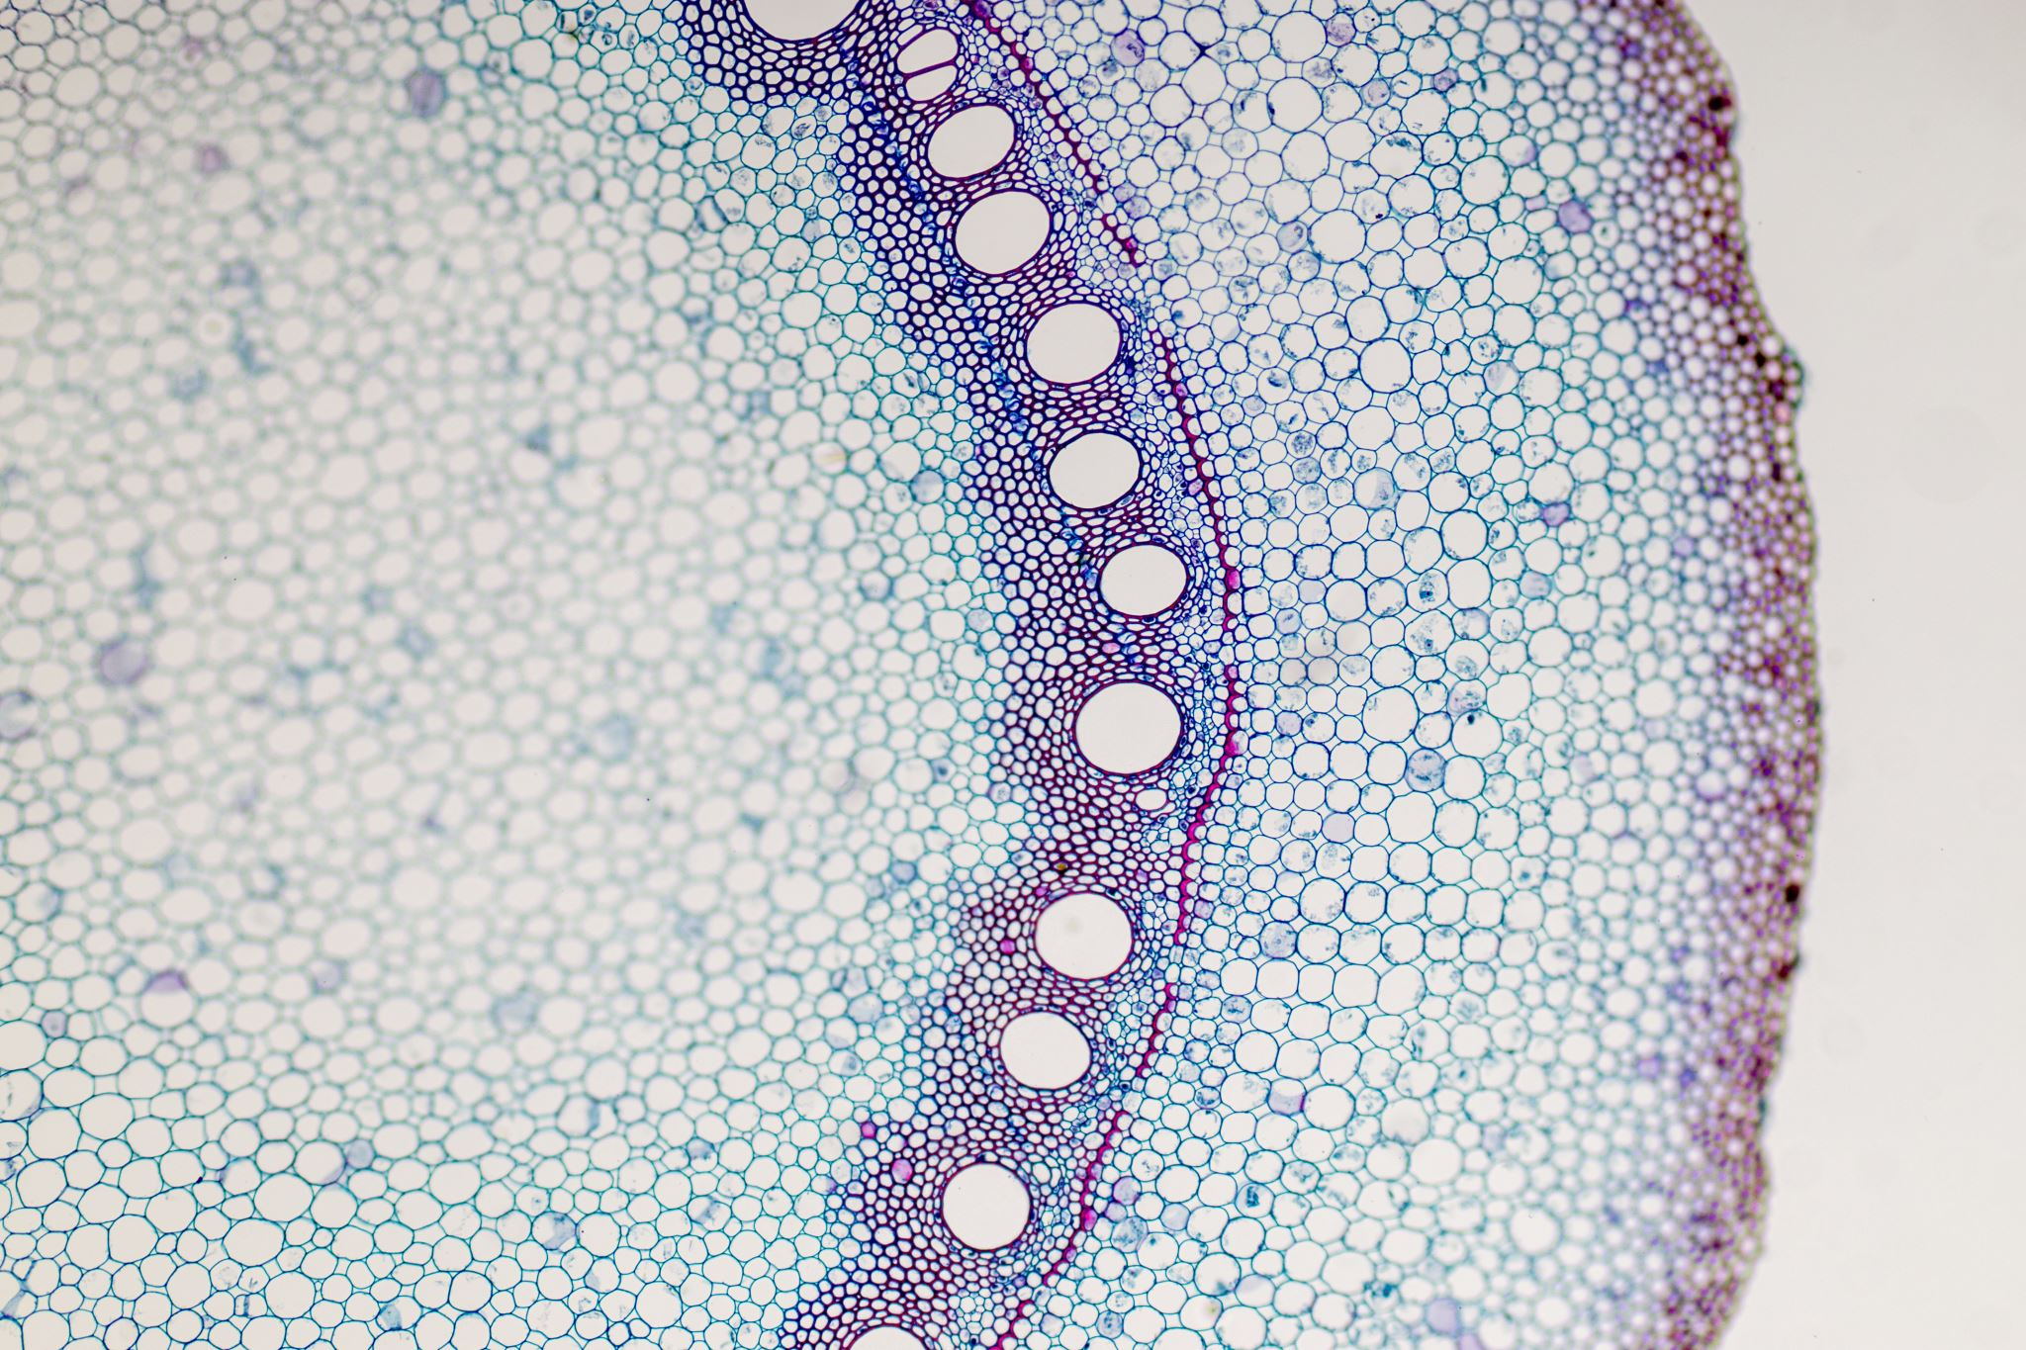
The following slides are examples for each slide

Slide 10
Slide 2
Table of Content
Slide 3 Introduction…………………………………………………………………………………2
Slide 4 organigram meaning and benefits…………………………………………….….4
Slide 5 organigram for ABC mental care home………………………………………….5
Slide 6-Information about chosen staff for training needs…………………..……6
Slide 7- learning activity for chosen staff………………………………………….….… .7
Slide 8- SWOT for the chosen staff…………………………………….........….…………8
SLIDE 9- Training needs required for chosen staff (CPD)……..……….……..……9
Slide 10- CPD Plan for chosen staff…………………………………………………………10
Slide 11- Conclusion……………………………………………………………………………….11
Slide 12- Reference………………………………………………………………………………..12

Slide 11
SLIDE 3
Introduction- This report is to design an organigram for ABC mental home situated in the heart of London.
ABC mental home is a 25 capacity rooms with 35 residents.
This organigram is designed by the mental home manager for one of the staff members of ABC mental home
This training needs analysis was identified during two different activities; work shadowing and appraisal section for the particular staff chosen.

Slide 12
Slide 4-
An organogram
An organogram is a graphical representation of an organisation’s structure.
It’s used to show hierarchical relationships between managers and the people who report to them, as well as departments.
An organogram is a useful tool for organisations to both visualise reporting relationships and communicate employees’ names, skills, and contact information.
The term "organogram" is used most often in the UK and is synonymous with "org chart.“ (ref…..)

Slide 13
SLIDE 5
Use to show hierarchical information or reporting relationships in an organization, with corresponding pictures.
It’s the most common type of organizational structure––the chain of command goes from the top (e.g., the CEO or manager) down (e.g., entry-level and low-level employees) and each employee has a supervisor (ref….)
Hierarchical org structure
T.A
Manager ABC Care Home
V.O
Supervisor
J.T
Care co-ordinator
M.W
Care Assistant
Y.K
Care Assistant

Slide 14
Slide 6-
Chosen staff for training needs-
Miss J.T, Care co-Ordinator ABC mental home
In ABC mental home, the care teams comprise of a Care Coordinator and a small team of carers split across the three service areas, Home care carer, respite carer and the Live-In Carer.
A care coordinator job is often the single most important role involved in the care of any individual patient. Supervising interdisciplinary care by bringing together the different specialists whose help the patient may need, the coordinator is also responsible for monitoring and evaluating the care delivered (ref…)

Slide 15
Slide 7
The following are the activities that leads to CPD for ABC Mental home care coordinator:
Work shadowing-
Shadowing involves witnessing everything the patient experiences, observing and recording each step of the process, and then seeking feedback from the patient at each point. Job shadowing is the opportunity to observe an employee performing their daily work routine in their environment. It allows you to explore specific careers and to get a realistic picture of the tasks performed for that job.
Appraisals-
Is a formal documented system for the periodic review of an individual's performance. It is a means of assessing performance to make plans for correcting shortcomings, developing potential, and initiating training or effecting staff transfers and promotions.

Slide 16
My strengths (What am I good at? What do I do well?) | My weaknesses (How can I improve? What do I need to work on?)
Opportunities (Who/What can help meet to achieve my targets/goals?) | Threats (What obstacles do I face? Who/What may get in my way?)
PERSONAL SWOT ANALYSIS
SLIDE 8- SWOT ANALYSIS FOR ABC MENTAL CARE HOME

Slide 17



Slide 9
Skills identified for staff training needs
Communication skills- communication may influence a patient's mental health through a number of different pathways. In a much-cited review, communication skills are associated with several positive better service users outcomes such as higher satisfaction, better service users adherence and symptom resolution (ref…)
Leadership- is the most influential factor in shaping organisational culture, so ensuring the necessary leadership strategies, behaviours and qualities are developed is fundamental to health service improvement (ref…)
Time management- When you master time management, you'll feel more empowered, less stressed, and able to achieve goals on both a daily and long-term basis—not to mention, you'll have more energy to share quality time with your aging loved one. Time management skills can be improved by setting a SMART goals, set weekly priorities, time block your schedule, delegate tasks, avoid Multitasking and experiment with different time management techniques (ref…)

Slide 18
SLIDE 10-

Slide 19
The following slides are information to support your task 2 assignment write-up!

Slide 20

Models of organizational structure
Hierarchical org structure
Functional org structure
Horizontal or flat org structure
Divisional org structures (market-based, product-based, geographic)
Matrix org structure
Team-based org structure
Network org structure.

Slide 21
Categories
Work-based learning- For example, reflecting on experiences at work, considering feedback from service users or being a member of a committee.
Professional activity- For example, being involved in a professional body or giving a presentation at a conference.
Formal education- For example, going on formal courses or carrying out research.
Self-directed learning- For example, reading articles or books.
Several different types of learning count as CPD activities
Any activity from which you learn or develop professionally can be considered eligible for CPD, though you should ensure that these complement your practice and enhance the service you provide.

Slide 22
Activities that leads to CPD in healthcare sector
Reflective practice
Audit of service users
Coaching from others
Discussions with colleagues
Peer review
Work shadowing
Secondments
Job rotation
Receiving or providing supervision.
Audit
Appraisal section
Shadowing a colleague or other professional.
Significant analysis of events
Project work
Filling in self-assessment questionnaires
Gaining and learning from experience
Involvement in the wider, profession-related work of your employer (for example, being a representative on a committee)

Slide 23
Possible strengths
Communication skills
Empathy
Attention to details
Problem solving skills
Willingness to learn
Critical thinking
Time management
Leadership
Flexibility
Endurance
Open-Mindedness
Physical endurance
Quick Response
Respectfulness
Versatility
Physical stamina
Assertiveness
Reliability
Organisational skills
Neatness
The Ability to Prioritize
Compassion
Ethics
The Ability to Delegate
Interpersonal Skills
Respect

Slide 24
Possible weaknesses
Goal-setting.
Communication.
Collaboration. ... Enhance communication skills.
Listen to your mentor.
Upgrade your skills.
Listening.
Conflict resolution.
Adaptability.
Organization.
Accepting constructive feedback.
Work well on a team.
Communication skills (listening, speaking and writing)
Analytical and research skills.
Flexibility/adaptability.
Interpersonal abilities.
Ability to make decisions and solve problems.
Ability to plan, organise and prioritise work.
Ability to wear multiple hats.
Leadership/management skills.
Complete a professional certificate or degree.
I sometimes lack confidence.

Slide 25
Types of CPD learning Activity:
Attending courses and lectures.
In-house team training.
Study days.
Educational parts of professional meetings.
Online learning or multimedia learning.
Private study.
Reading journals.
Distance learning.
Staff training
Audit and peer review.
Educational workshops at conferences.
Clinical refresher experience.
Shadowing a colleague or other professional.
Receiving or providing clinical supervision.
Mentoring (either being a mentor or receiving mentoring).
Learning journeys, such as visiting a centre of excellence.
Completing a reflective diary.
Action learning sets.
Research activity.
Preparing and presenting papers/articles.
Time spent developing or updating a personal development plan.

Slide 26
Work based learning
Learning by doing
Case studies
Reflective practice
Audit of service users
Coaching from others
Discussions with colleagues
Peer review
Work shadowing
Secondments
Job rotation
Journal club
In-service training
Supervising staff or students
Expanding your role
Significant analysis of events
Project work
Filling in self-assessment questionnaires
Gaining and learning from experience
Involvement in the wider, profession-related work of your employer (for example, being a representative on a committee)

Slide 27
Professional Activities
Lecturing or teaching
Mentoring
Being an examiner
Being a tutor
Involvement in a professional body, specialist-interest group or other groups
Maintaining or developing specialist skills (for example, musical skills)
Giving presentations at conferences
Organising journal clubs or other specialist groups
Organising accredited courses
Being an expert witness
Supervising research or students
Being a national assessor

Slide 28
Formal Education
Courses
Further education
Research
Attending conferences
Writing articles or papers
Going to seminars
Distance or online learning
Planning or running a course
Going on courses accredited by a professional body

Slide 29
Self-directed
Reading journals or articles
Reviewing books or articles
Keeping a file of your progress
Updating your knowledge through the internet or TV
Other
Relevant public service or voluntary work

Slide 30
Reference list
Lee, S.M., Luthans, F. and Olson, D.L., 1982. A management science approach to contingency models of organizational structure. Academy of Management Journal, 25(3), pp.553-566.
Child, J., 1972. Organizational structure, environment and performance: The role of strategic choice. sociology, 6(1), pp.1-22.
Hannan, M.T., Freeman, J.H. and Meyer, J.W., 1976. Specification of models for organizational effectiveness. American Sociological Review, 41(1), pp.136-143.
https://www.yourarticlelibrary.com/organization/organisation-meaning-concept-features-and-advantages/63768
https://www.nhsconfed.org/resources/key-statistics-on-the-nhs
https://www.kingsfund.org.uk/sites/default/files/field/field_publication_file/leadership-leadership-development-health-care-feb-2015.pdf
https://www.caring.com/articles/caregiver-time-management/
https://www.skillsforcare.org.uk/Documents/Learning-and-development/Core-skills/Communication-skills-in-social-care.pdf

